Slide 1

Smart Contract Vulnerabilities: Hacking, Detecting, and Preventing
A deep dive into the world of smart contract vulnerabilities. Learn how to hack, detect, and prevent exploits//
Jayavamsi Villuri - CEH Master, Software Engineer, Wannabe Security Engineer / Blockchain Enthusiast https://velofjay.netlify.app | LinkedIn | X | Email

Slide 2
Contents
1
Introduction
2
Terminology
3
Ethernaut: Learn by Hacking
4
Vulnerabilities
5
Detection Strategies
6
Prevention Strategies

Slide 3

Terminology
Smart Contract
Self-executing agreement on the blockchain.
Gas
Unit of computation cost in Ethereum.
Solidity
Primary programming language for Ethereum contracts.
EVM
Ethereum Virtual Machine – the runtime environment.

Slide 4
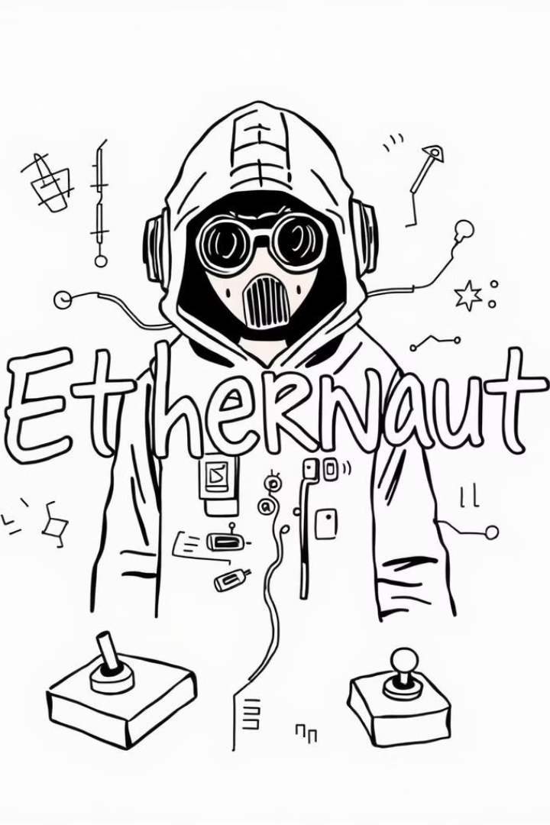
Game On: Crack Smart Contracts with Ethernaut
1
Hack Your Way to Mastery
Game-based security puzzles for Ethereum smart contracts
2
Exploit to Protect
Practice exploiting common vulnerabilities in a controlled environment
https://ethernaut.openzeppelin.com/ | Ethernaut-Setup

Slide 5
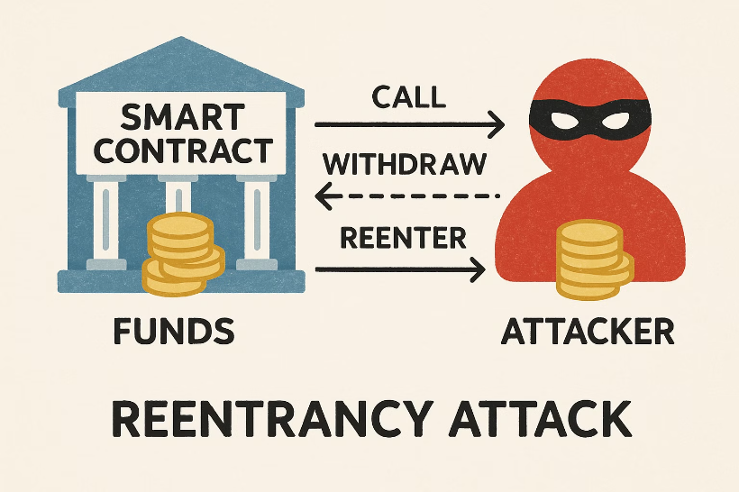
Vulnerability #1: Reentrancy
Malicious contract recursively calls a vulnerable function.
Occurs before state updates. Phone call interrupting withdrawal allows repeated withdrawals.

Slide 6

Vulnerability #2: Integer Overflow/Underflow
Calculations exceeding or falling below the representable range. Results in unexpected behavior.
A counter resetting to its maximum value after reaching zero.

Slide 7

Vulnerability #3: Timestamp Dependence
Critical logic relies on block timestamps.
Miners can manipulate timestamps. Gambling game outcome based on current block timestamp.

Slide 8

Vulnerability #4: Gas Limit & Loops
Unbounded loops exhaust gas limits.
Contract execution halts.
Infinite loop causes a program to freeze.

Slide 9
Vulnerability #5: Front Running
Observing pending transactions for profit.
Trader seeing another's order and placing their own order ahead.
Executing a more profitable one before it.

Slide 10



Detection & Prevention
Detection
Prevention
Static analysis ( Slither / Mythril )
Secure coding
Audits
Formal verification
Bug bounties
Fuzzing

